Slide 1


Jorge Israel Frómeta Moya
November 1st, 2024

Slide 2

Outline
Executive Summary
Introduction
Methodology
Results
Conclusion
Appendix

Slide 3
Executive Summary
Summary of methodologies
Data Collection:
Accessed data from SpaceX API and Wikipedia including web scraping.
Data Processing:
Collected, filtered, and cleaned data from separate sources and stored in CSV files.
Exploratory Data Analysis (EDA):
Generated visualizations to examine launch site performance, orbit success rates, and success trends over time, also perform SQL queries to analyze launch site usage, NASA payload contributions, and landing outcomes.
Interactive Visualization Tools:
Developed interactive maps and charts using Folium and Dash for dynamic data exploration.
Predictive Modeling:
Trained multiple models (Logistic Regression, SVM, Decision Tree, KNN) with hyperparameter tuning using GridSearchCV, identified the most accurate model and analyzed key features influencing performance.

Slide 4
Executive Summary
Summary of all results
Launch Site Success:
Identified certain launch sites with consistently higher success rates, suggesting location impact on mission outcomes.
Orbit and Success Correlation:
Found specific orbits with higher success rates, providing insights for optimal mission planning.
Improvement Over Time:
Observed a positive trend in success rates, indicating improvements due to technological advancements.
Predictive Model Performance:
Best Model: Decision Tree Classifier with 0.9444 accuracy and 0.96 F1 score.
Top Features: Legs and ReusedCount emerged as key indicators of success, emphasizing the role of reusability in outcomes.

Slide 5
Introduction
Project background and context
Overview of SpaceX's Success: SpaceX with reusable rockets, particularly through the Falcon 9 model, can reach significantly lower launch costs (estimated at $62 million per launch, compared to $165 million from other providers). A large portion of these savings comes from reusing the first stage of the rocket.
Problems you want to find answers
Primary question:
Can we accurately predict the likelihood of the first-stage landing success, given key mission parameters?
Secondary question:
What factors (payload, orbit type, etc.) most strongly influence the success of first-stage landings?

Slide 6

Section 1

Slide 7
Methodology
Executive Summary
Data collection methodology:
Describe how data was collected
Perform data wrangling
Describe how data was processed
Perform exploratory data analysis (EDA) using visualization and SQL
Perform interactive visual analytics using Folium and Plotly Dash
Perform predictive analysis using classification models
How to build, tune, evaluate classification models

Slide 8
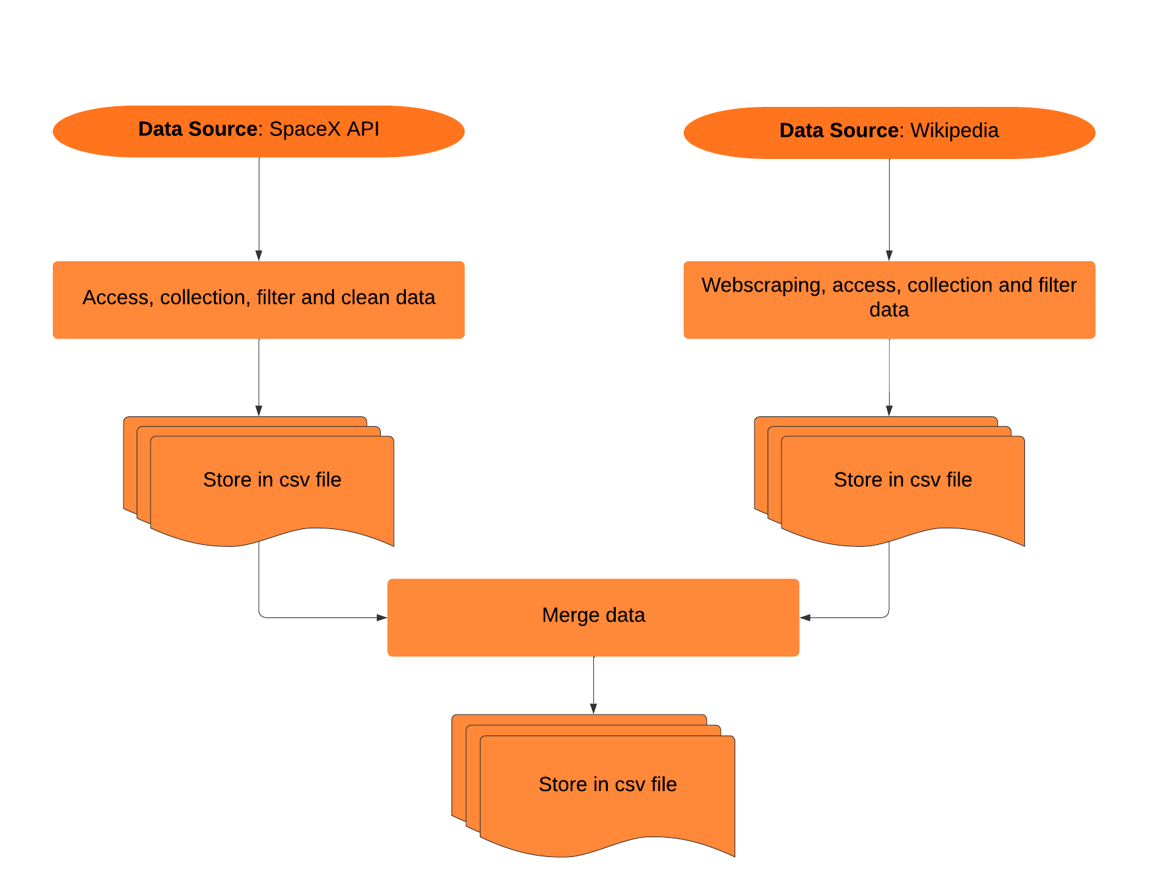
Data Collection
Data access to sources: SpaceX API and Wikipedia.
Collection, filter and clean data from separated sources (including webscraping).
Store in separated csv files and then merged on a single csv file.

Slide 9
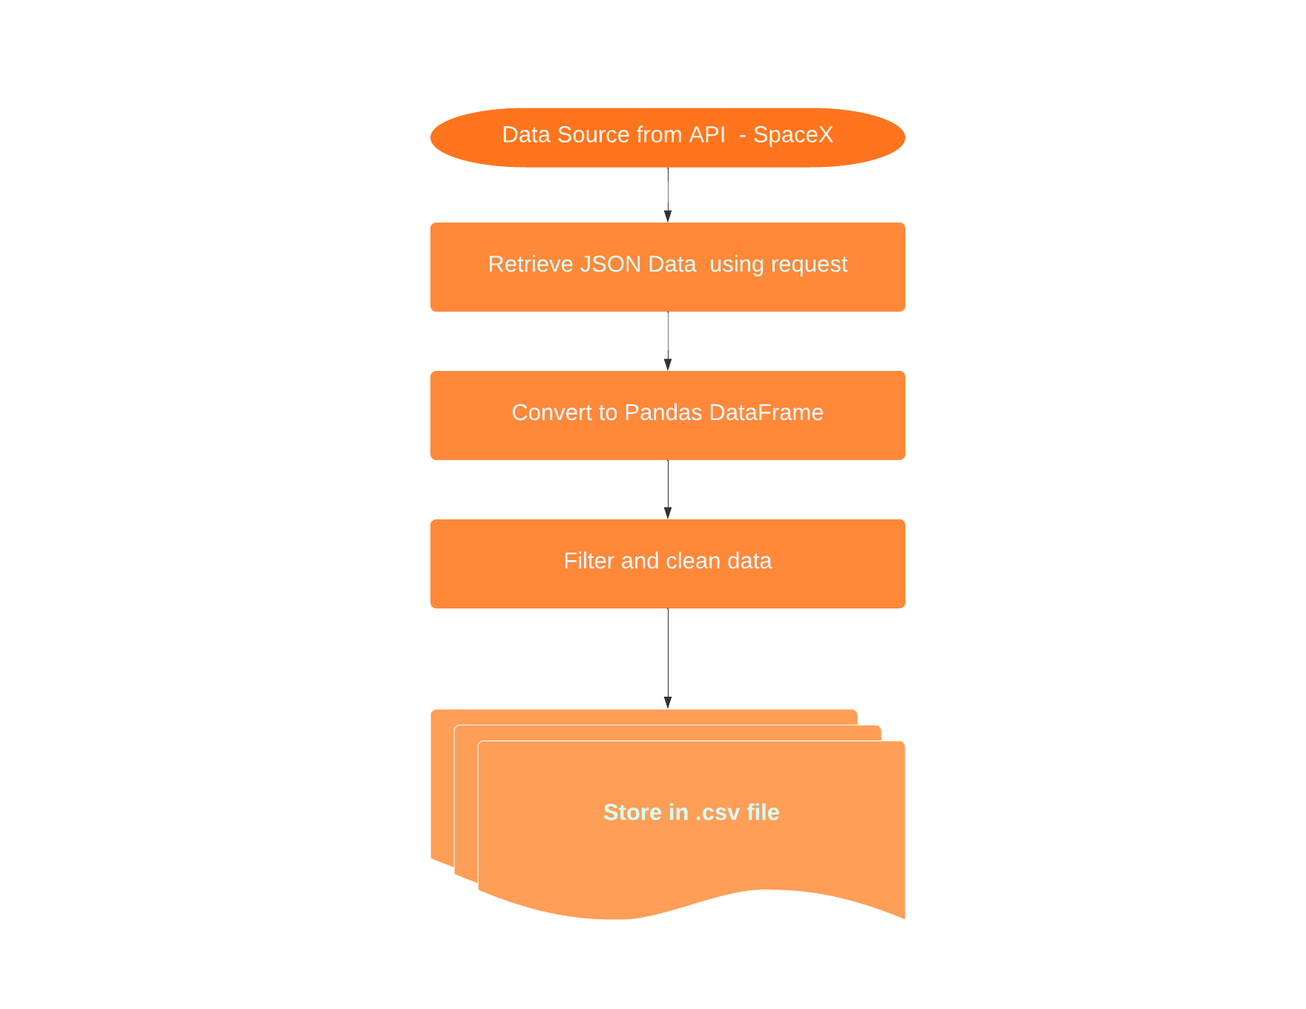
Data Collection – SpaceX API
Data collected from SpaceX API (https://api.spacexdata.com/v4/launches/past) using Python's requests module.
Use Python requests module to access data.
Convert JSON data to Pandas DataFrame for processing.
Filter relevant columns (e.g., payload, launch date, orbit type), impute missing values.
Store the cleaned data as a CSV file for further analysis.
Code and process details available in GitHub Notebook:
https://github.com/jfrometa88/Applied-Data-Science-Capstone-IBM/blob/main/jupyter-labs-spacex-data-collection-api-v2.ipynb

Slide 10
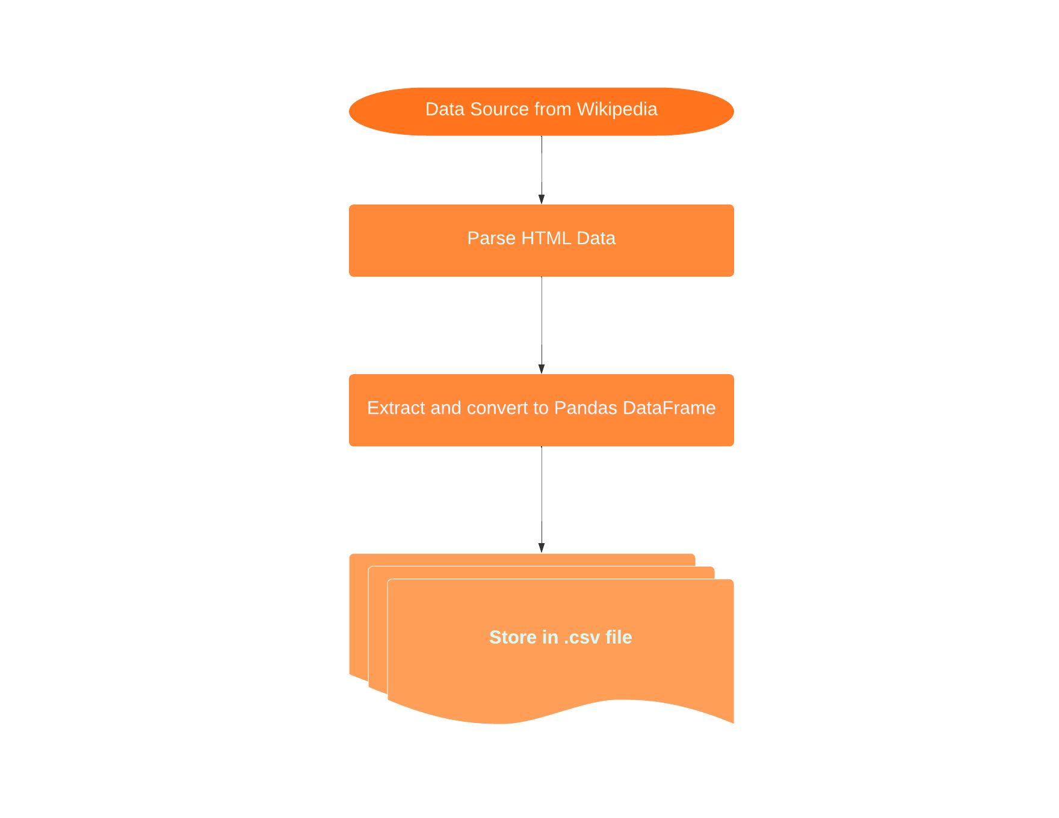
Data Collection - Scraping
Data access from Wikipedia (https://en.wikipedia.org/wiki/List_of_Falcon_9_and_Falcon_Heavy_launches) using Python's requests module.
Parse HTML with BeautifulSoup
Extract relevant tables and convert to Pandas DataFrame.
Store the data as a CSV file for further analysis.
Code and process details available in GitHub Notebook:
https://github.com/jfrometa88/Applied-Data-Science-Capstone-IBM/blob/main/jupyter-labs-webscraping.ipynb

Slide 11

Data Wrangling
Data access from collected data.
Exploration of data format using pandas module.
Define and process the target variable as a binary variable for further analysis.
Store the data as a CSV file for further analysis.
Code and process details available in GitHub Notebook:
https://github.com/jfrometa88/Applied-Data-Science-Capstone-IBM/blob/main/labs-jupyter-spacex-Data%20wrangling-v2.ipynb

Slide 12
EDA with Data Visualization
Charts used and their Purpose:
Flight number vs Launch site and succes or failed outcome (categorical plot): to identify patterns of success across launch sites and analyze if certain sites have consistently higher success rates
Payload mass vs Launch site and succes or failed outcome (categorical plot): to determine if heavier or lighter payloads have a higher success rate at specific launch sites.
Orbit vs Success rate (bar plot): to assess whether certain orbits are associated with higher or lower success rates, informing planning for mission type and destination.
Flight number vs Orbit and succes or failed outcome (categorical plot): to examines if particular orbit types tend to have more successful landings, especially for rockets with higher flight numbers.

Slide 13
EDA with Data Visualization
Charts used and their purpose:
Payload mass vs Orbit and succes or failed outcome (categorical plot): to help identify any correlations between payload mass and success rates for specific orbits, guiding payload planning.
Average success rate over time (line plot): to track overall trends in SpaceX’s success rate over time, showing improvements and identifying periods with significant advancements.
Data preparation steps:
Dummy variables: Created for categorical columns to enable model compatibility.
Data type casting: Numeric columns cast to float64 for consistency in numerical operations.
Code and process details available in GitHub Notebook:
https://github.com/jfrometa88/Applied-Data-Science-Capstone-IBM/blob/main/jupyter-labs-eda-dataviz-v2.ipynb

Slide 14
EDA with SQL
SQL queries used and their Purpose:
Unique Launch Sites: Retrieved distinct launch site names used in space missions to understand site distribution.
Launch Sites Beginning with 'CCA': Queried the first 5 records of launch sites starting with "CCA" for location-specific analysis.
Total Payload Mass for NASA (CRS): Calculated the total payload mass for missions launched by NASA (CRS), focusing on NASA's payload contributions.

Slide 15
EDA with SQL
SQL queries used and Their Purpose:
Date of First Successful Ground Pad Landing: Identified the date of the first successful landing outcome on a ground pad to mark milestones in reusability.
Boosters with Successful Drone Ship Landings (Payload 4000-6000): Listed booster names that successfully landed on drone ships with payloads between 4000 and 6000 kg.
Count of Successful and Failed Missions: Summed up the total number of successful and failed mission outcomes, giving an overview of mission reliability.
Boosters with Maximum Payload: Retrieved booster versions that carried the maximum payload mass, identifying high-capacity boosters.

Slide 16
EDA with SQL
SQL queries used and Their Purpose:
Failed Drone Ship Landings in 2015: Displayed records with month names, landing outcomes (failures on drone ships), booster versions, and launch sites specifically for 2015.
Ranked Landing Outcomes (2010-06-04 to 2017-03-20): Ranked landing outcome counts (e.g., Failure on drone ship, Success on ground pad) in descending order over a specific date range for outcome analysis.
Code and process details available in GitHub Notebook:
https://github.com/jfrometa88/Applied-Data-Science-Capstone-IBM/blob/main/jupyter-labs-eda-sql-coursera_sqllite.ipynb

Slide 17
Build an Interactive Map with Folium
Maps used and their purpose:
Marking launch sites: Plotted all SpaceX launch sites on an interactive Folium Map with Markers and Circle objects, providing a spatial overview of launch locations.
Visualizing launch outcomes: Marked each launch at its respective site on an interactive Folium Map with MarkerCluster object, color-coded by outcome (success or failure). Enabled quick visual assessment of site performance and success rates.
Distance calculation to nearest coast: Calculated and displayed the distance from each launch site to the nearest coastline on an interactive Folium Map with Markers and Polyline objects. Important for understanding proximity to water, which is relevant for safety and recovery planning.
Code and process details available in GitHub Notebook:
https://github.com/jfrometa88/Applied-Data-Science-Capstone-IBM/blob/main/lab-jupyter-launch-site-location-v2.ipynb

Slide 18
Build a Dashboard with Plotly Dash
Dashboard elements added:
Total and single site successful rate for launches (pie chart): Displays the overall count or rate of successful and failed launches across all launch sites or a selected single site. Provides a clear overview of launch site performance, helping identify high-performing locations and areas for improvement.
Payload mass vs. Launch success or fail and booster version (scatter chart): Plots payload mass against launch success or fail and booster version, showing the correlation between the variables. Helps analyze the impact of payload mass on launch success, guiding decisions on payload limits and mission planning.
Code and process details available in GitHub Notebook:
https://github.com/jfrometa88/Applied-Data-Science-Capstone-IBM/blob/main/spacex_dash_app.py

Slide 19
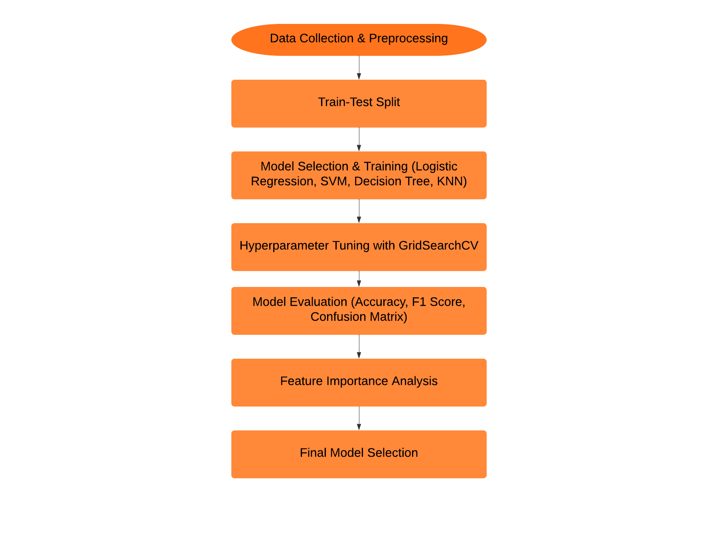
Predictive Analysis (Classification)
Key Steps in Model Development Process
1. Data Preprocessing:
Loaded and standardized dataset.
Split data into training and testing sets.
2. Model Selection and Initial Training:
Trained multiple classification models: Logistic Regression, SVM, Decision Tree, KNN.
Used GridSearchCV for hyperparameter tuning with cross-validation.
3. Model Evaluation:
Evaluated each model’s performance on test data using accuracy and F1 score.
Plotted confusion matrix for each model to assess prediction quality.

Slide 20
Predictive Analysis (Classification)
Key Steps in Model Development Process
4. Feature Importance Analysis:
Identified and visualized top features affecting model performance.
Compared feature importance for Logistic Regression and Decision Tree models.
5. Model Comparison and Selection:
Compared models based on cross-validation score, test accuracy, and F1 score.
Selected best-performing model for deployment.
Code and process details available in GitHub Notebook:
https://github.com/jfrometa88/Applied-Data-Science-Capstone-IBM/blob/main/SpaceX-Machine-Learning-Prediction-Part-5-v1.ipynb

Slide 21
Results
Exploratory data analysis results
Visualization for Key Patterns:
Launch Sites and Success: Compared launch sites and payloads to see which sites consistently perform better.
Orbit Success Rates: Identified orbits with higher success rates to inform mission planning.
Success Over Time: Tracked trends in SpaceX’s success rates to spot improvements.
SQL Queries for Targeted Insights:
Site and Payload Distribution: Mapped out launch site use and NASA's payload contributions.
Landing and Outcome Patterns: Analyzed milestones in reusability, success/failure counts, and patterns in failed drone landings.

Slide 22
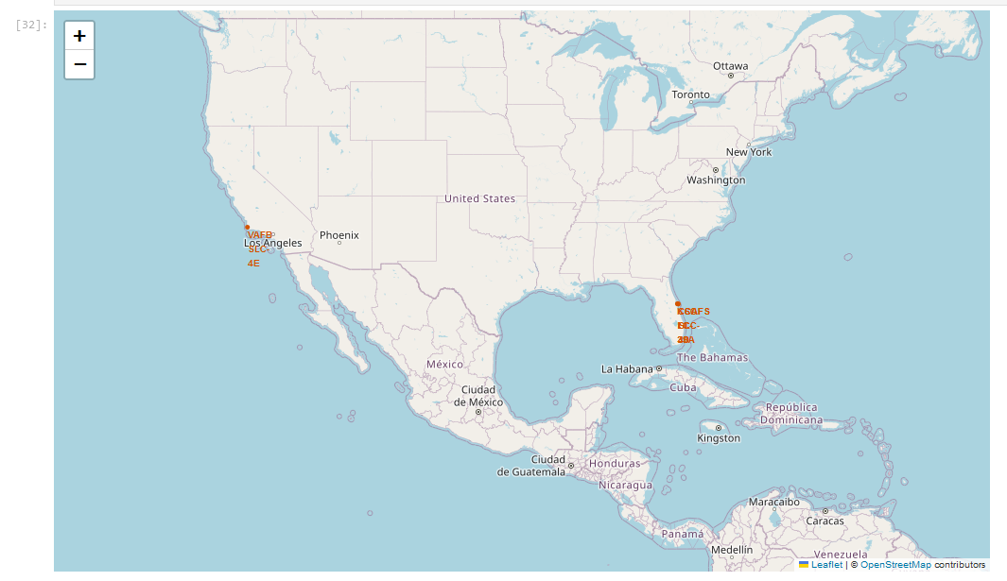
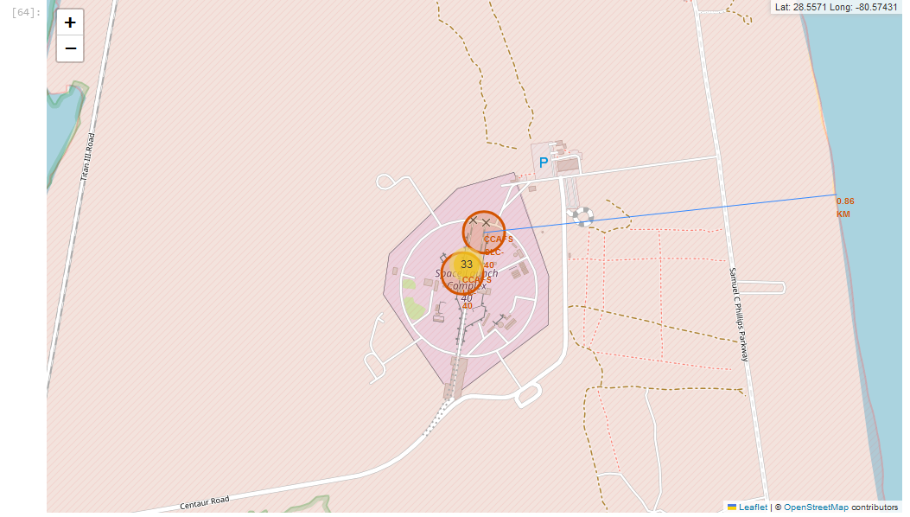
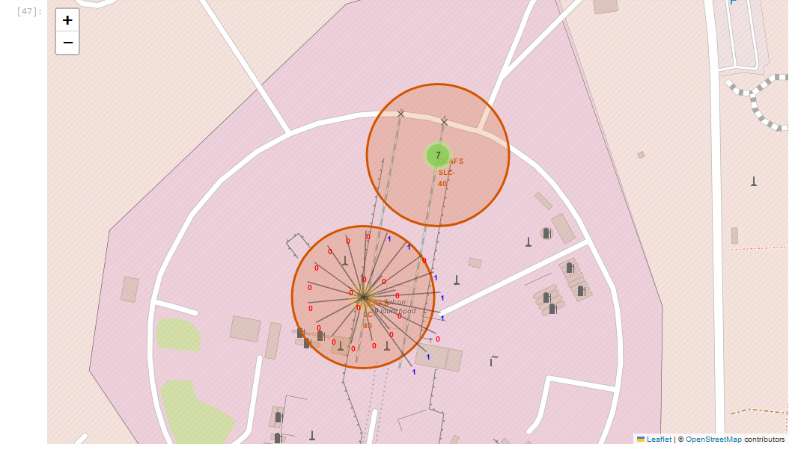
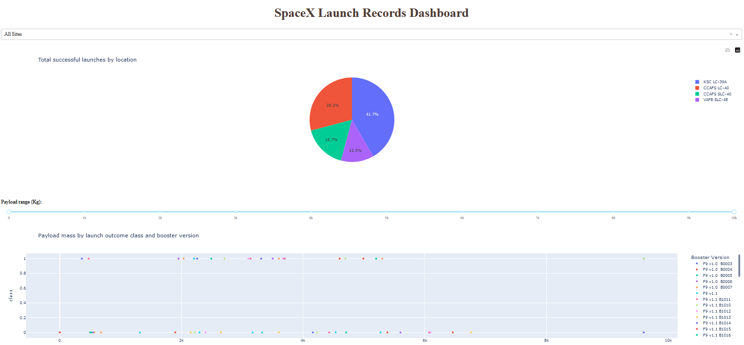
Results
Interactive analytics demo in screenshots

Slide 23
Results
Predictive analysis results
Trained multiple classification models: Logistic Regression, SVM, Decision Tree, KNN using GridSearchCV for hyperparameter tuning.
Decision Tree Classifier was the best model with the highest classification accuracy (0.9444) and F1 score of 0.96.
Identified and visualized top features affecting model performance for Logistic Regression and Decision Tree models.
Legs and ReusedCount appears to be the most importance features among others.

Slide 24

Section 2

Slide 25
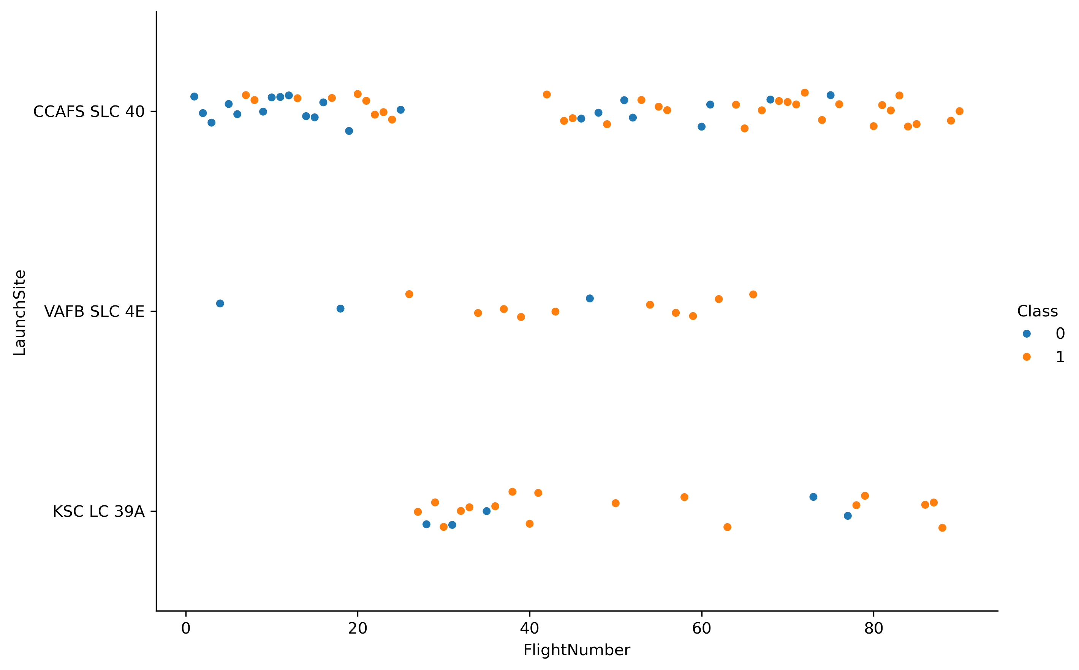
Flight Number vs. Launch Site
The plot suggests that CCAFS SLC 40 and KSC LC 39A are the primary sites for launches, while VAFB SLC 4E is used less frequently.
Despite fewer launches, VAFB SLC 4E shows a strong trend of success, indicating that this site might be used selectively.
Failures are more common in the early flight numbers, especially for launches from CCAFS SLC 40. This trend suggests a learning curve

Slide 26
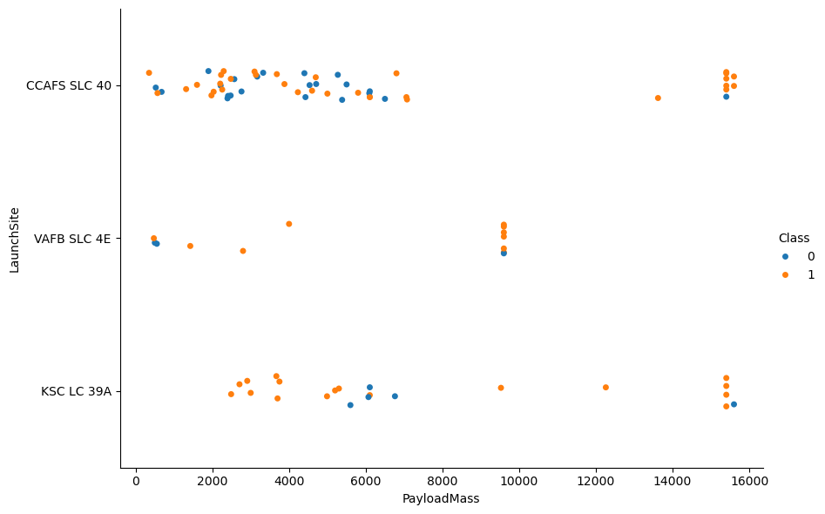
Payload vs. Launch Site
This chart highlights that heavier payloads (above 8000 Kg.) tend to have a higher success rate, possibly due to added caution, better planning, or more reliable rocket configurations.
There is not clear additional patterns remarking difference across launch sites.

Slide 27
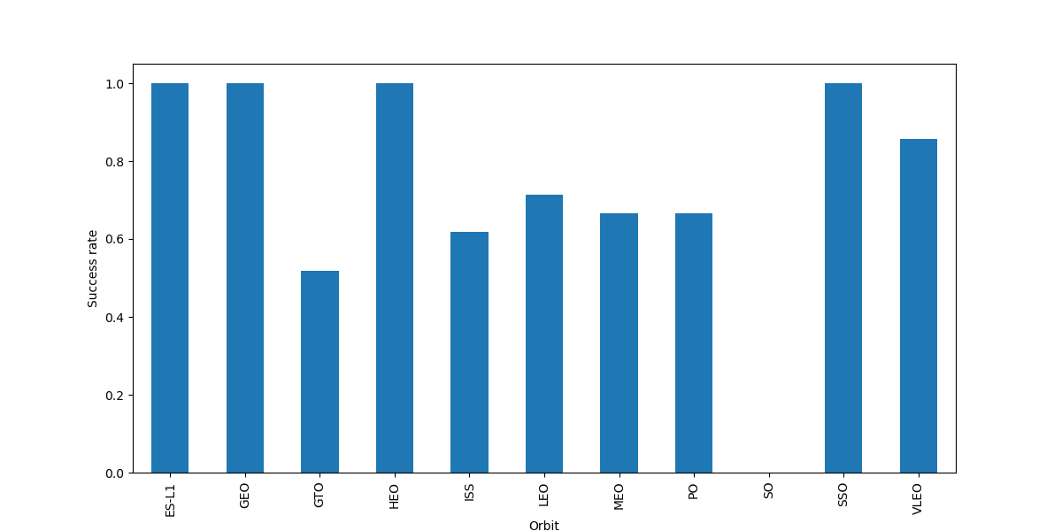
Success Rate vs. Orbit Type
ES-L1, GEO, HEO and SSO are the most successful orbits (100% or near).
GTO presents the poorest success rate (under 60%).

Slide 28
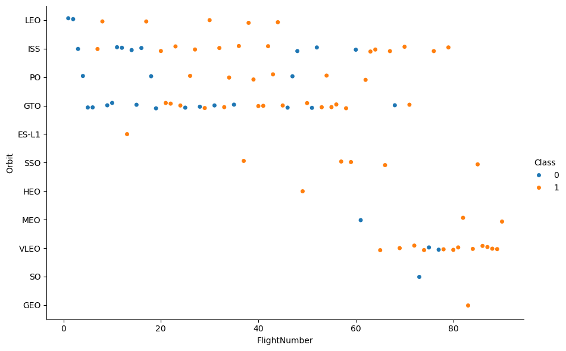
Flight Number vs. Orbit Type
ISS and GTO present more flights than others with a mix of success and failures, specially in GTO.
In LEO orbit the Success appears related to the number of flights.

Slide 29
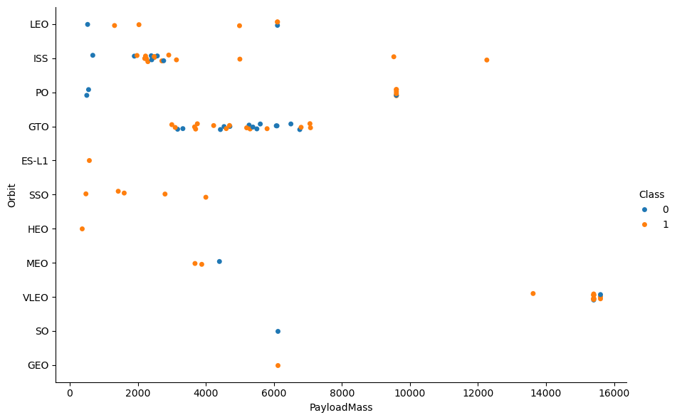
Payload vs. Orbit Type
With the increase of payload mass the successful landing or positive landing rate are more for Polar, LEO and ISS, although not great evidence is provided.
Not clear patterns for the others orbits.

Slide 30
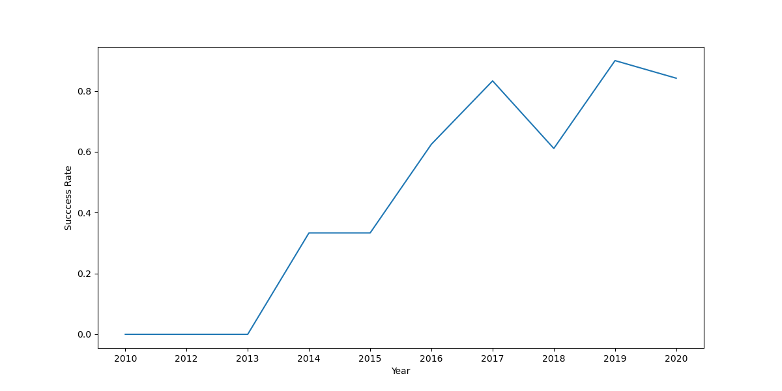
Launch Success Yearly Trend
There is a clear trend to get better Launch Success rate over the years, occasionally decreases like in 2018 and 2020.

Slide 31
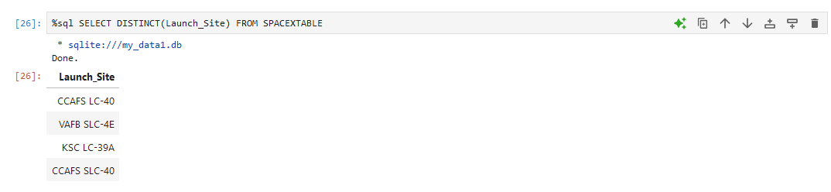
All Launch Site Names
There are 4 unique launch sites as appear in the picture.

Slide 32
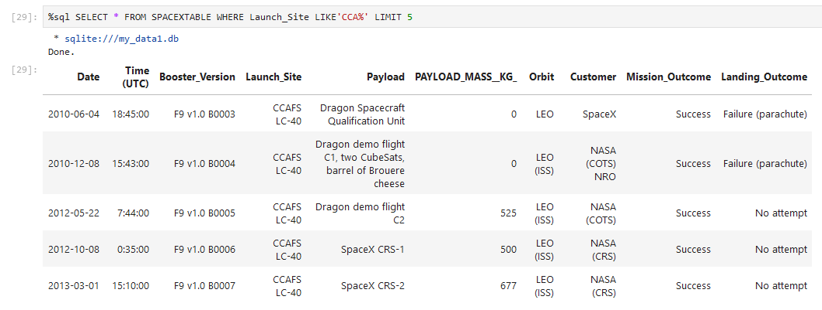
Launch Site Names Begin with 'CCA'
Only 1 launch site begin with `CCA`.
The query retrieves 5 records from launch site CCAFS LC-40.

Slide 33
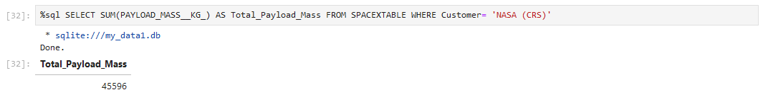
Total Payload Mass
The total payload carried by boosters from NASA was 45596 Kg.

Slide 34
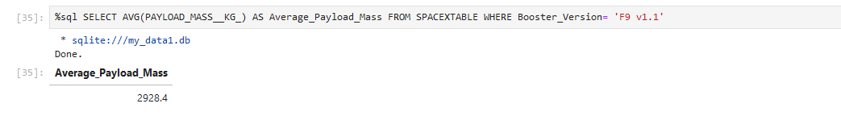
Average Payload Mass by F9 v1.1
The average payload mass carried by booster version F9 v1.1 was 2928.4 Kg.

Slide 35
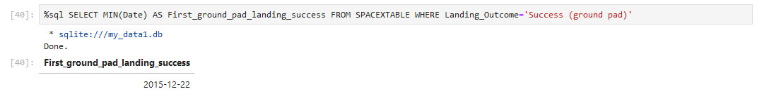
First Successful Ground Landing Date
December 22, 2015 was the date of the first successful landing outcome on ground pad.

Slide 36
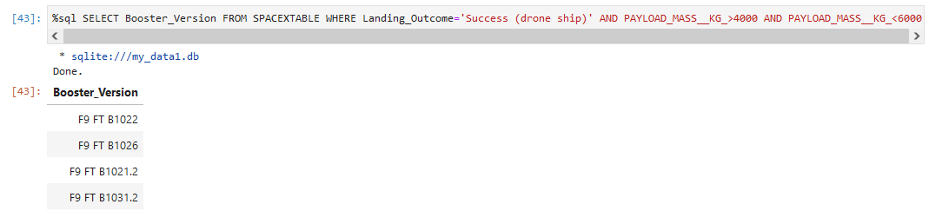
Successful Drone Ship Landing with Payload between 4000 and 6000
4 boosters versions have successfully landed on drone ship and had payload mass greater than 4000 but less than 6000 as shown in picture.

Slide 37
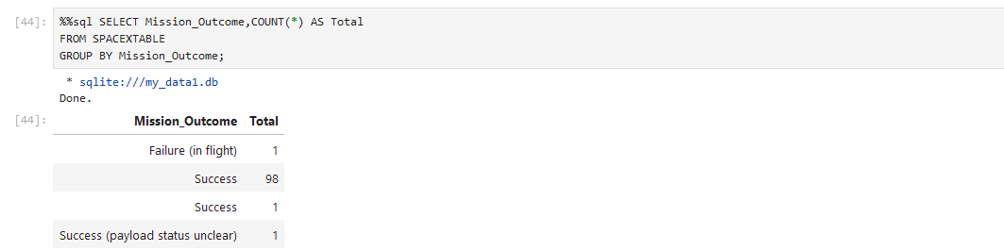
Total Number of Successful and Failure Mission Outcomes
The total number of successful mission outcomes was 100 and just 1 failure mission outcome.

Slide 38
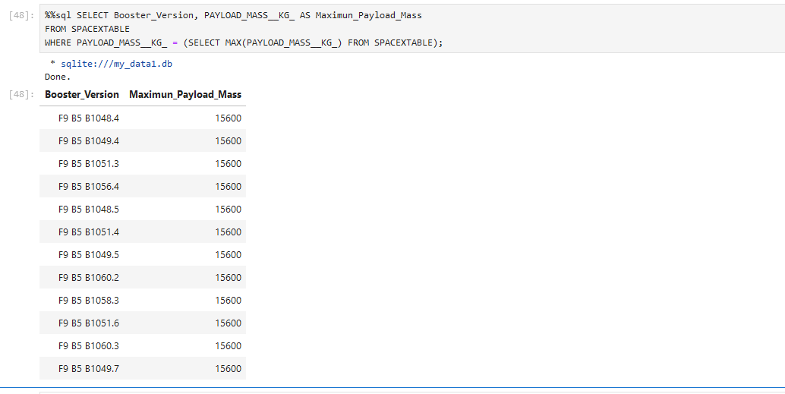
Boosters Carried Maximum Payload
The maximum payload mass was 15600 Kg., carried by 12 different booster versions.

Slide 39
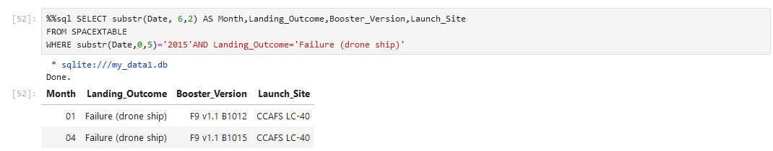
2015 Launch Records
2 different failed landing_outcomes in drone ship occurs in year 2015, the query retrieves the booster versions, and launch site name.

Slide 40
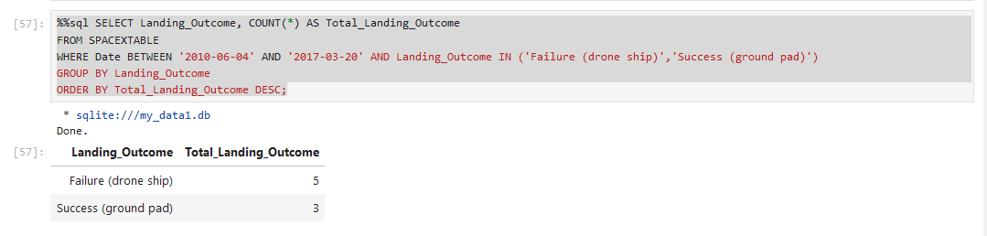
Rank Landing Outcomes Between 2010-06-04 and 2017-03-20
Failure (drone ship) occurs 5 times and Success (ground pad) occurs 3 times between the date 2010-06-04 and 2017-03-20.

Slide 41

Section 3

Slide 42
Launch Sites Locations Map
The launch sites are located on the Pacific and Atlantic coasts of United States of America. Specifically, in the states of Florida and California.

Slide 43
Successed or failed launch according location
It can be easily identify which launch sites have relatively high or low success rates from the color-labeled markers.

Slide 44
Distance to nearest coast according launch location
Distance to the coast is less than 1 kilometer, which is relevant for safety and recovery planning.

Slide 45

Section 4

Slide 46
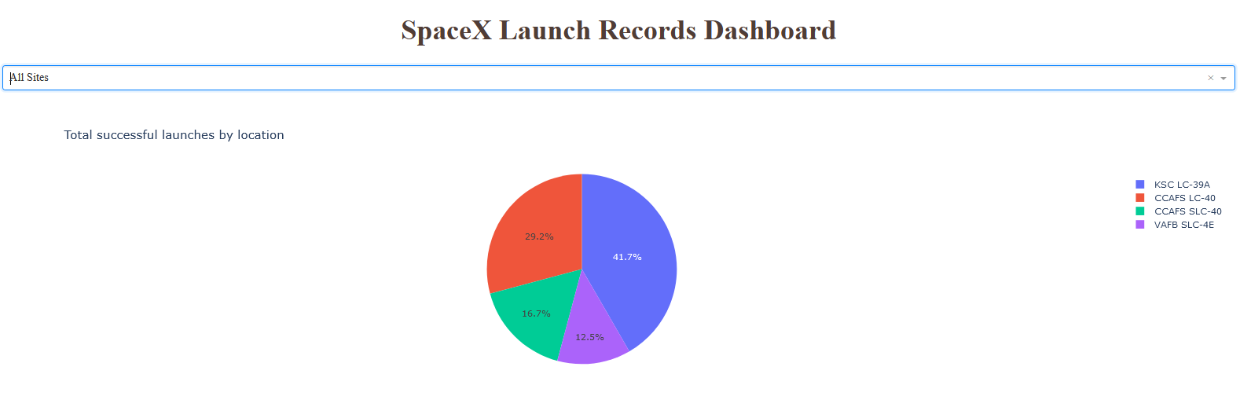
Successful launches count for all sites
The data suggests KSC LC-39A is the most frequently used site for successful launches, highlighting its significance in SpaceX's launch operations.

Slide 47
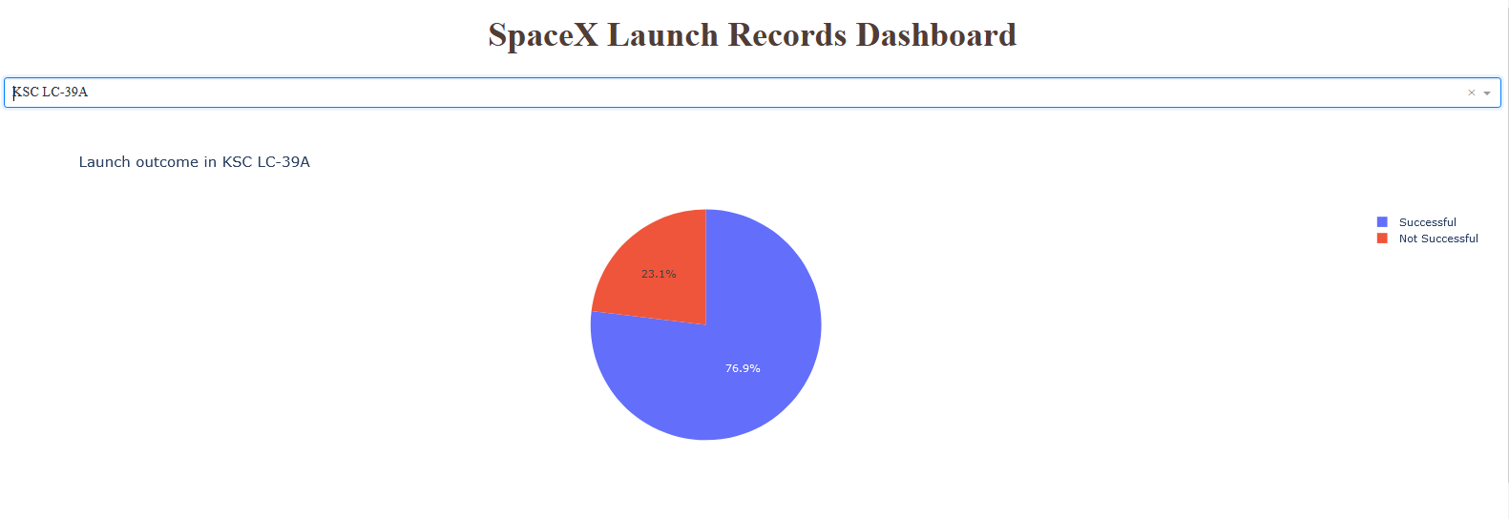
Success vs. Failed counts for a specific site
The data suggests that, KSC LC-39A is the most frequently used site for successful launches because its higher success ratio.

Slide 48
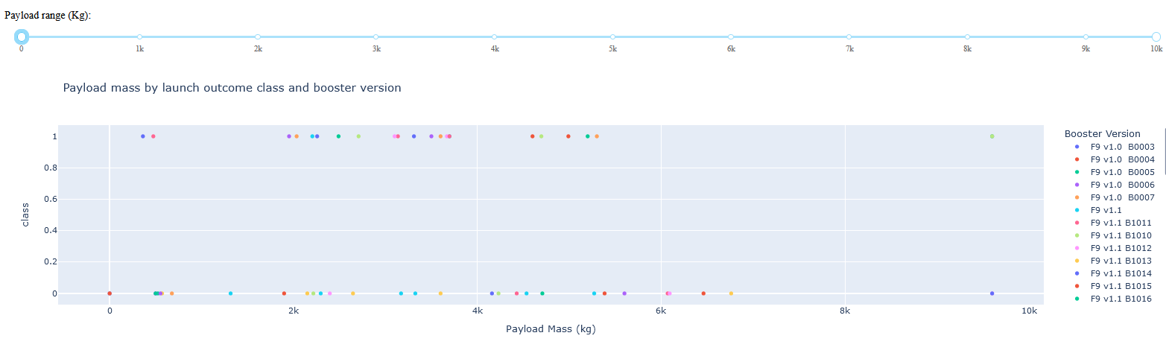
Relation between Payload Mass, Success or Fail and Booster version
A clear correlation between the variables represented in the chart is not readily apparent.

Slide 49

Section 5

Slide 50
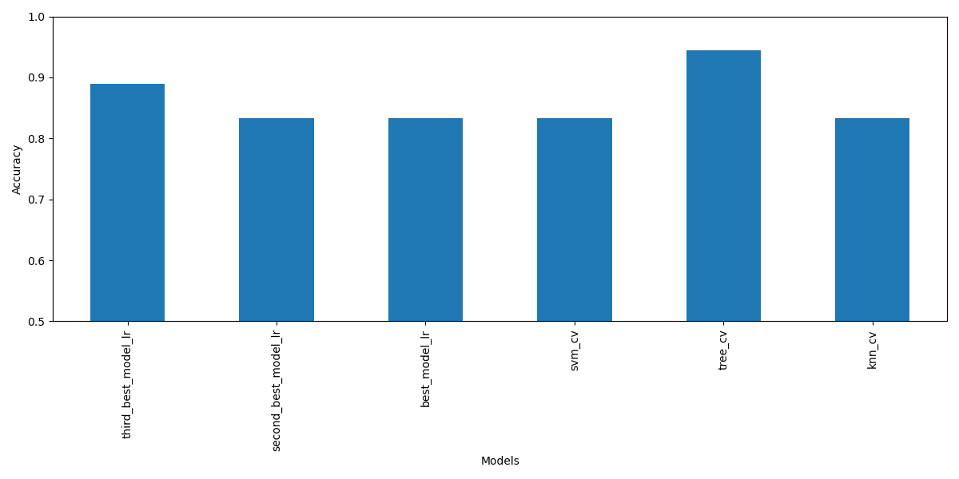
Classification Accuracy
Decision Tree Classifier was the best model with the highest classification accuracy (0.9444).

Slide 51
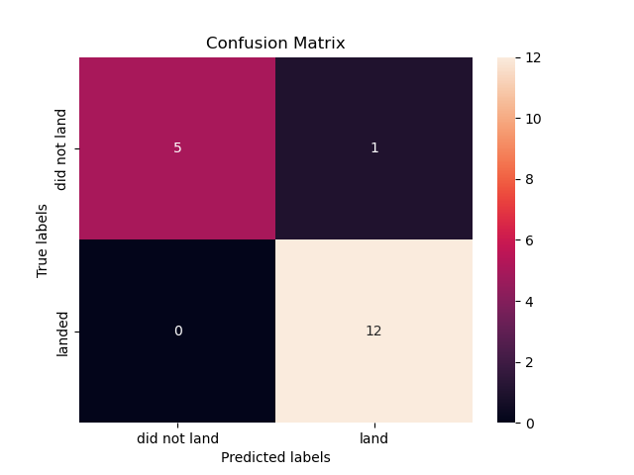
Confusion Matrix
The confusion matrix shows good performance of the model Decision Tree Classifier on unseen data, even with the class imbalance in the target variable, as demonstrated by an F1 score of 0.96.

Slide 52
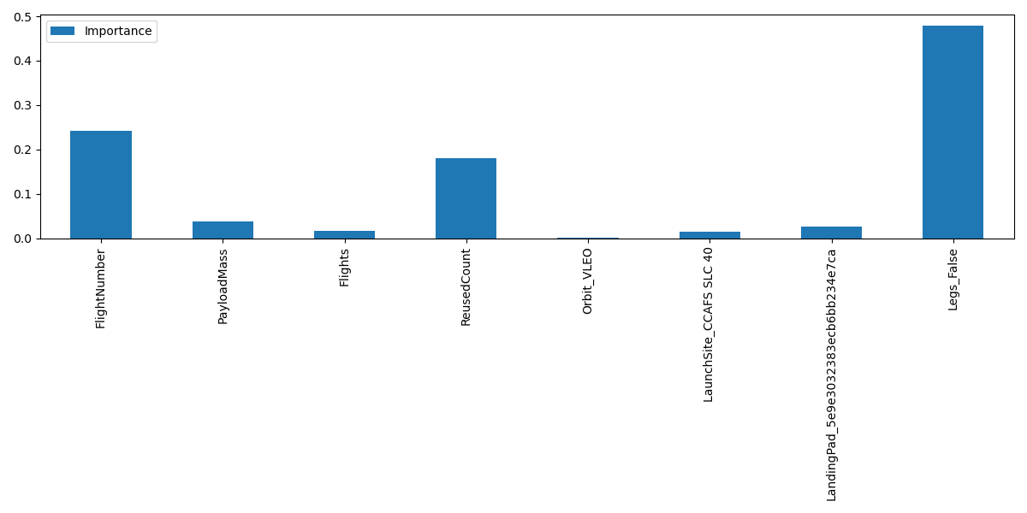
Features importance (Decision Tree Classifier)
The analysis of the features importance in the Decision Tree Classifier model reveals in the chart the most significant features, with variables Legs, FlightNumber and ReusedCount standing out.

Slide 53
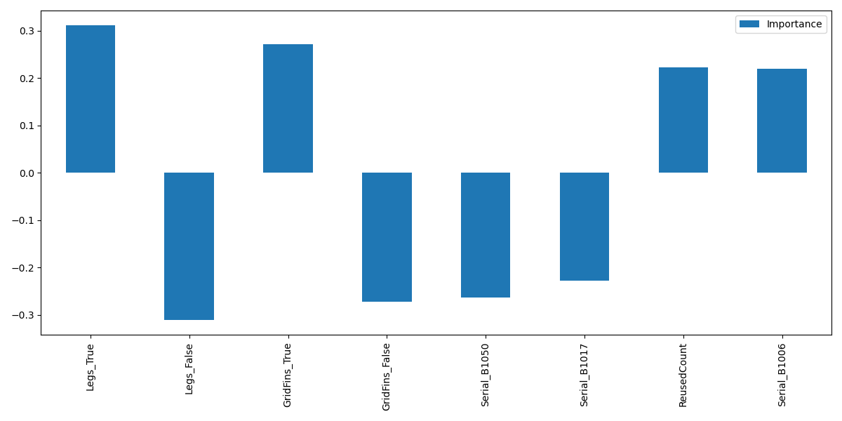
Features importance (Logistic Regression)
The analysis of the features importance in the Logistic Regression model (as the second best model) reveals in the graph the most significant features according to coefficient values, with variables Legs and ReusedCount matching coincidence respect the Decision Tree Classifier.

Slide 54
Conclusions
Key Analysis Findings
1. Exploratory Analysis Highlights:
Launch Site Success Rates: Certain launch sites perform consistently better, highlighting site-specific factors that may impact success.
Orbit Success Patterns: Higher success rates were found for specific orbits, guiding optimal mission destination planning.
Improvement Over Time: Clear upward trend in success rates, showing the impact of technological advancements.
2. SQL-Based Insights:
Landing and Outcome Patterns: Identified reusability milestones and failure patterns, especially in drone landings, to refine future landing approaches.

Slide 55
Conclusions
3. Interactive Visualization for Deeper Insights
Created dynamic maps and analytics dashboards with Folium and Dash to allow interactive data exploration.
4. Predictive Modeling Results
Models Trained: Logistic Regression, SVM, Decision Tree, KNN (using GridSearchCV for tuning).
Best Model: Decision Tree Classifier with accuracy of 0.9444 and F1 score of 0.96.
Key Features Identified: Legs and ReusedCount among others emerged as the most influential features for model performance.

Slide 56
Conclusions
The analysis revealed actionable insights on launch site effectiveness, optimal orbits and other factors influencing success. Interactive tools and predictive models, especially the Decision Tree, provided a robust framework for improving mission planning and enhancing reusability strategies.

Slide 57
Appendix
All the code, charts and stored data created during this project is available in:
https://github.com/jfrometa88/Applied-Data-Science-Capstone-IBM

Slide 58


